Slide 1
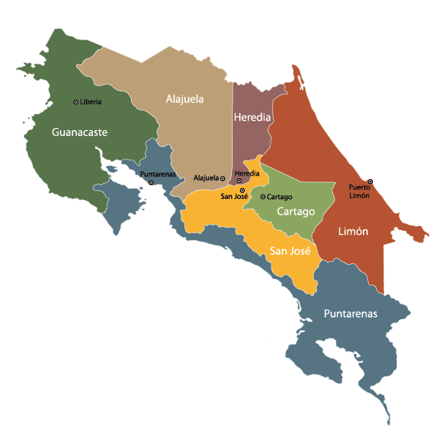
Poverty level indicators for Costa Rican Households
Instructor:
Dr. José Unpingco
Date: 12/7/2018
Group 7:
Scott Zhao
Yuchun Hsieh
Qihan Zhang
GaUTAM Nain

Slide 2
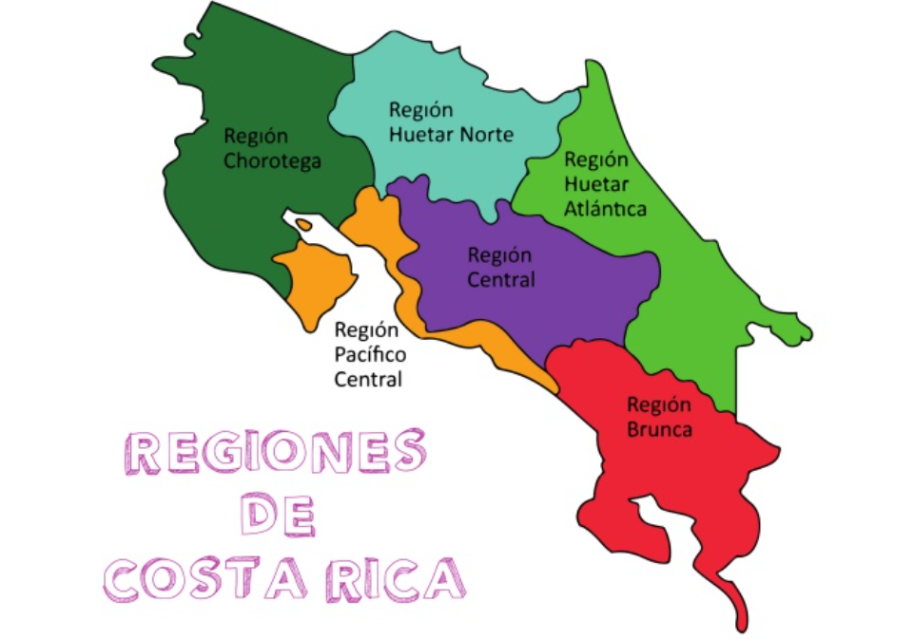
Introduction
Population: 4,857,274 people
Density: 84/km²
Poverty index: 21.1% in 2018 (1,142,069 people in poverty, while 360,783 people live in extreme poverty.)

Slide 3
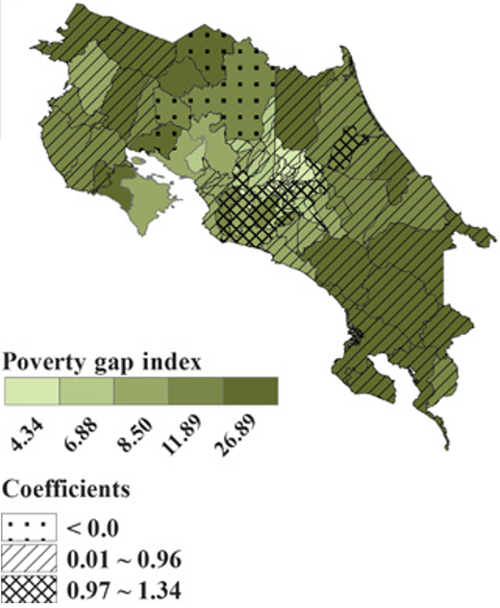
Motivation
The big poverty gap in Costa Rica is a serious problem as 1.1 million people live in poverty.
Investigating different relations between socio-economic parameters is a worthy task.
Understanding the indicators and the factors affecting poverty will help us in tackling this problem in a better way.

Slide 4
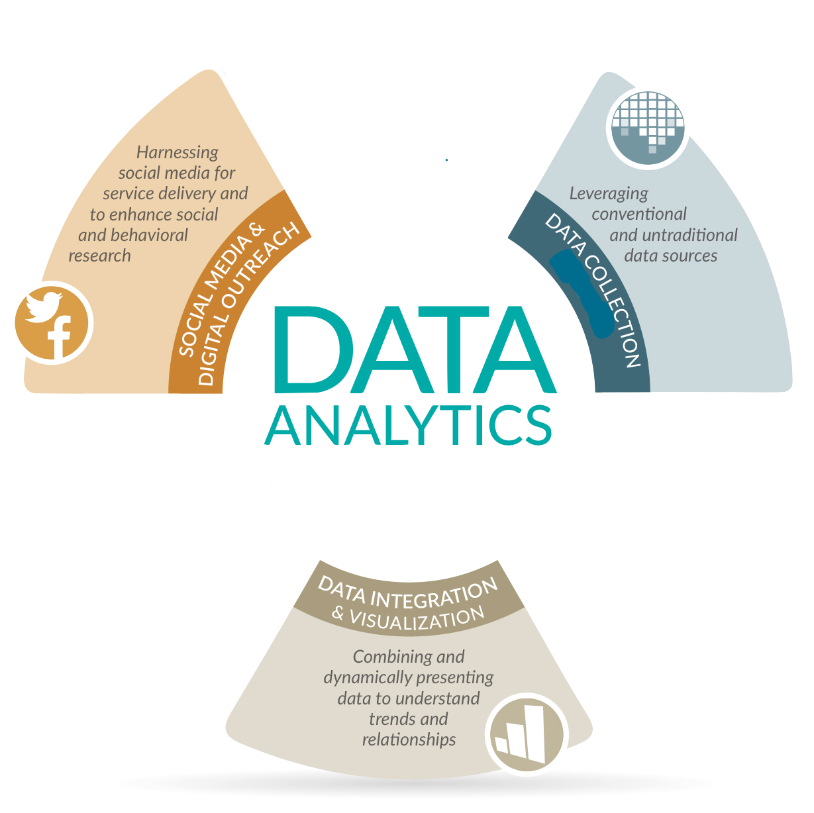
Datasets
IDB Costa Rican Household Dataset: 143 features as poverty level indicators with target labels classified
INEC Costa Rica Dataset: Costa Rican official census data
Google and twitter search data

Slide 5

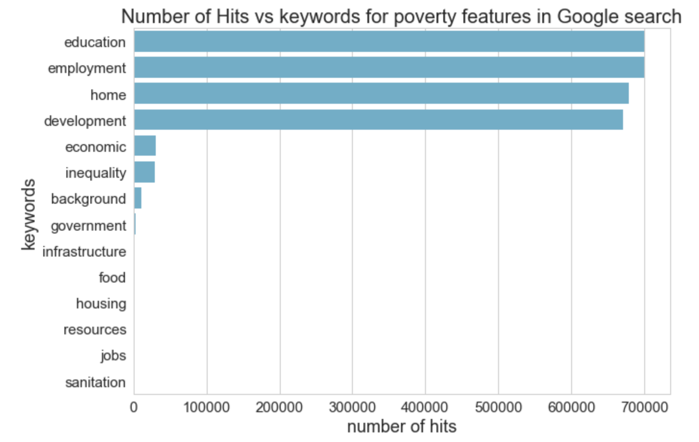
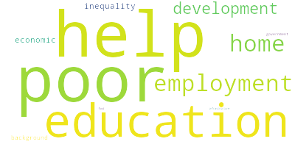
Google it up!

Slide 6
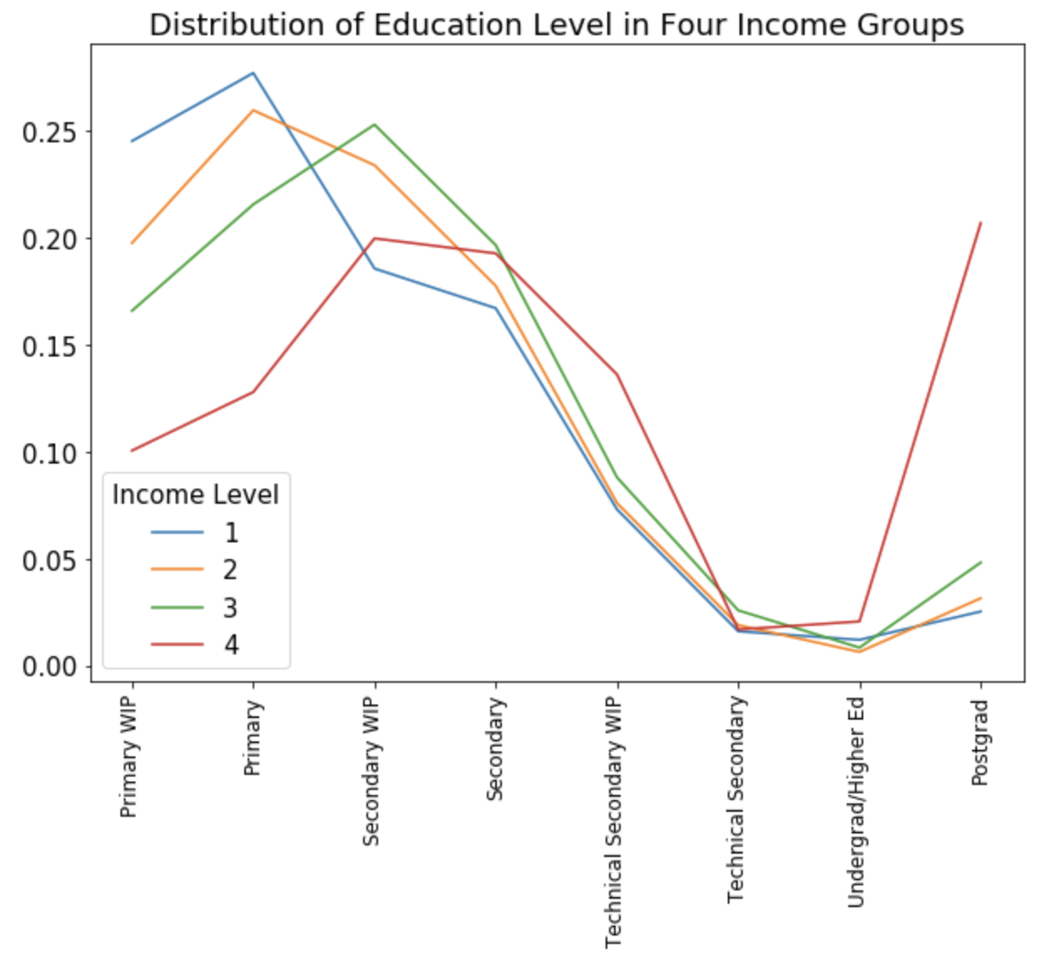
Education
Income Level:
1→ extreme poverty
2→ moderate poverty
3→ vulnerable poverty
4→ non-vulnerable poverty

Slide 7
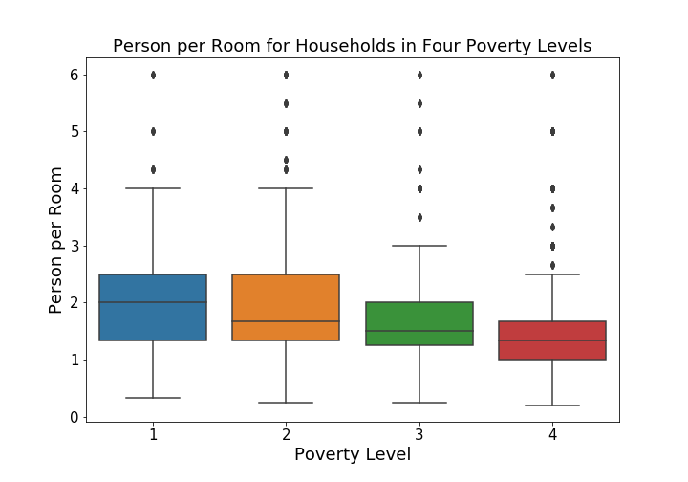
Overcrowding
Poverty Level:
1→ extreme
2→ moderate
3→ vulnerable
4→ non-vulnerable

Slide 8
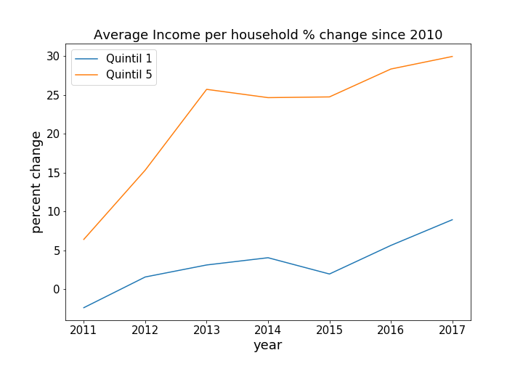
Income inequality continues to Grow
Inflation Rate ~ 5% Year on Year

Slide 9
Different Regions and Provinces of Costa Rica:

Slide 10
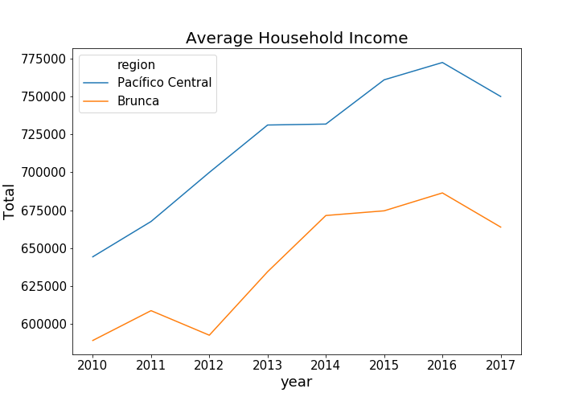
Income Growth for Different Regions and Provinces:

Slide 11
Economy (Number of Established companies in Costa Rica)

Slide 12
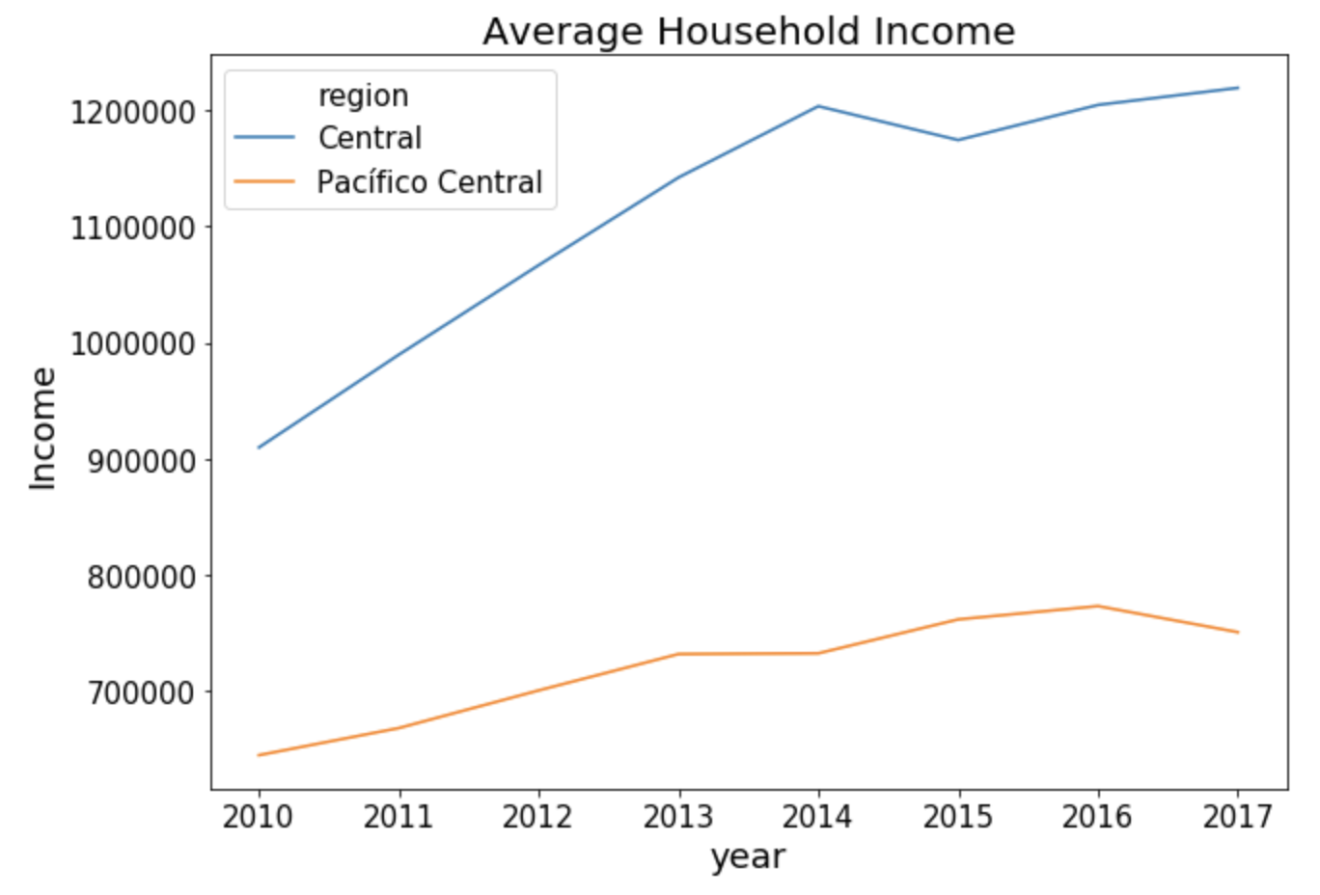
Impact of Change in Number of companies on income:

Slide 13

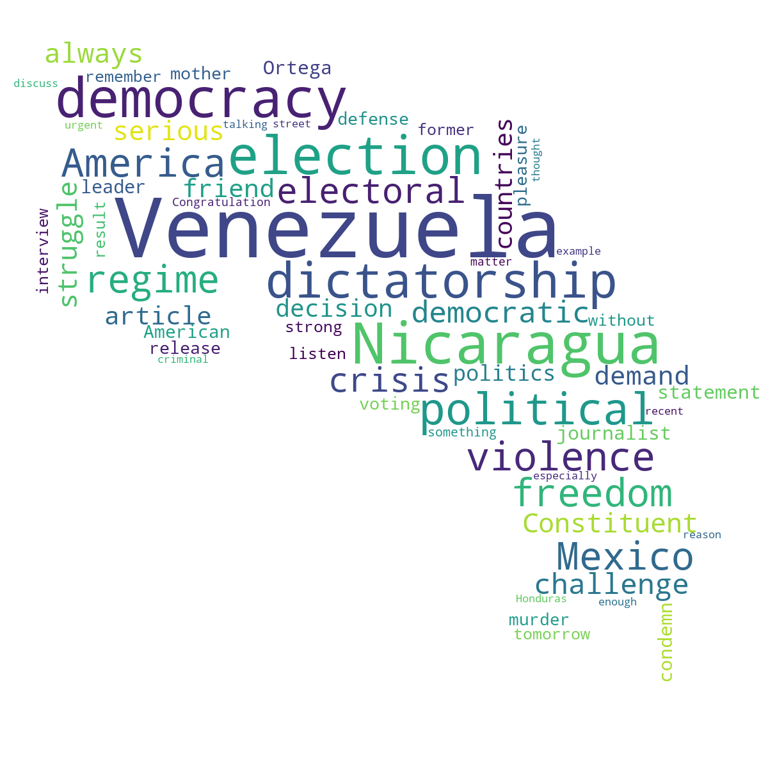
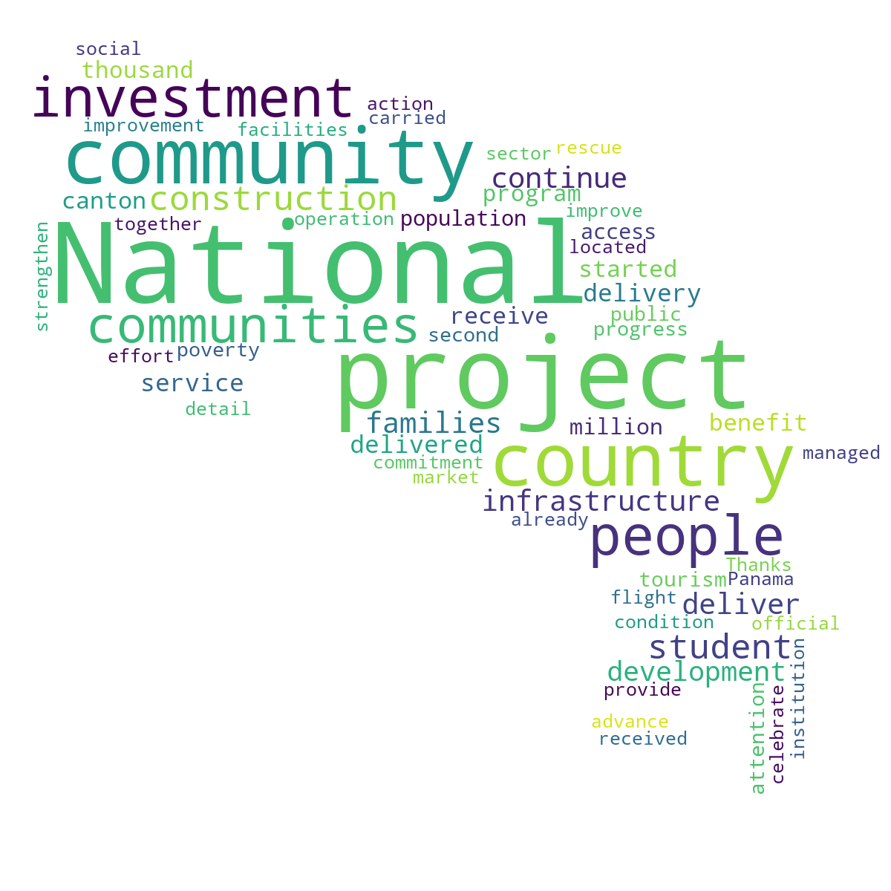

Laura Chinchilla
President of Costa Rica
(2010-2014)
140 Character reveals a lot
Luis Guillermo Solis
President of Costa Rica
(2014-2018)

Slide 14
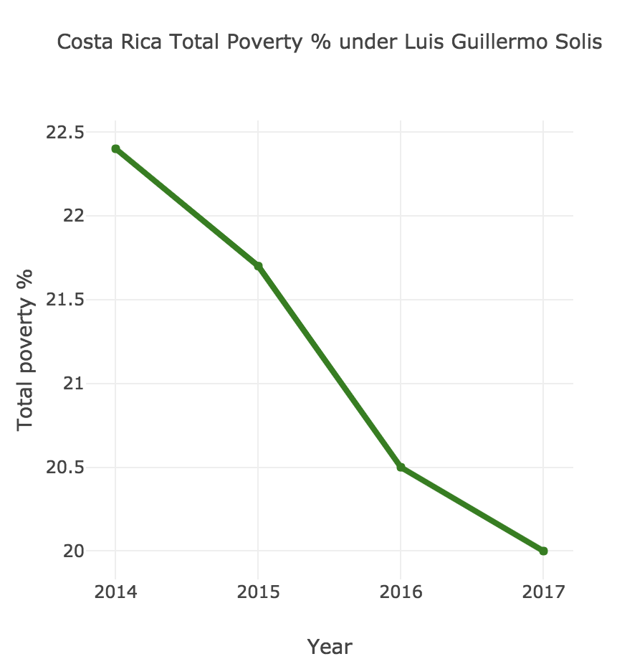
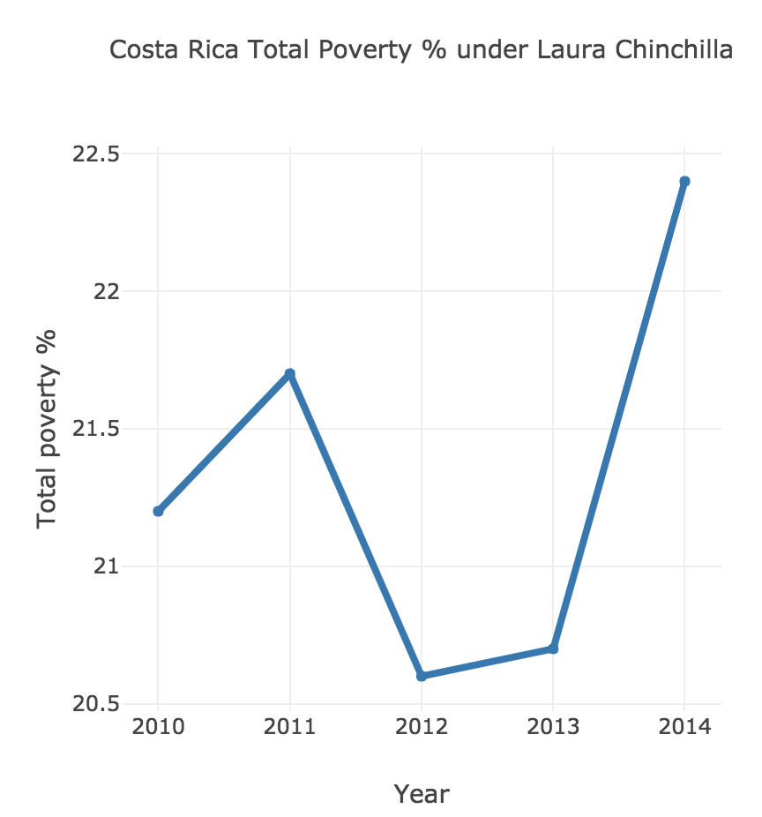
Poverty Levels during different Tenures’

Slide 15
Conclusion
We can conclude that the government has a big role to play to overcome poverty in Costa Rica.
New Industries needs to be setup to increase per capita income
Income Inequality continues to grow further
Education has a huge role to play and the government needs to focus in this direction.
Housing is another one of the important poverty indicators and steps needs to be taken to improve that.

